Slide 1
Data Structures
CONTENTS:
Data Structure (Appendix A)
Network Representation (Section 2.3)
READING ASSIGNMENTS:
Chap 1, 2, 3
Appendix A, B
Notes:
Obtain a network, and use the same network to illustrate the shortest path problem for communication networks, the max flow problem, the minimum cost flow problem, and the multicommodity flow problem. This will be a very efficient way of introducing the four problems. (Perhaps under 10 minutes of class time.)

Slide 2
Overview of this Lecture
A very fast overview of some data structures that we will be using this semester
  lists, sets, stacks, queues, networks, trees
  a variation on the well known heap data structure
  binary search
Illustrated using animation
We are concerned with O( ) computation counts, and so do not need to get down to C- level (or Java level).

Slide 3
Two standard data structures
1
2
3
4
5
6
7
8
9
10
1
0
1
1
0
1
0
1
0
0
Array: a vector: stored consecutively in memory, and typically allocated in advance
first
This is a singly linked list
1
3
4
6
8
cells: hold fields of numbers and pointers to implement lists.

Slide 4
Two standard data structures
1
2
3
4
5
6
7
8
9
10
1
0
1
1
0
1
0
1
0
0
Each has its advantages. Each can be more efficient than the other. It depends on what operations you want to perform.
first
1
3
4
6
8
Let’s consider which data structure to use for working with node subsets, or arc subsets.

Slide 5
Two key concepts
Abstract data types: a descriptor of the operations that are permitted, e.g.,
  abstract data type: set S
  initialize(S): creates an empty set S
  add(S, s): replaces S by S ∪ {s}.
  delete(S, s): replaces S by S \{s}
  FindElement(S, s): s := some element of S
  IsElement(S, s): returns true if s ∈ S
Data structure: usually describes the high level implementation of the abstract data types, and can be analyzed for running time.
  doubly linked list, etc

Slide 6
A note on data structures
Preferences
  Simplicity
  Efficiency
  In case there are multiple good representations, we will choose one

Slide 7
Storing a subset S of Nodes
Operations
create an empty set S
S = ∅
S = {2}
S = {2, 7}
add an element to S
S = {2, 4, 7}
delete an element from S
S = {2, 4}
determine if a node is in S
Is 7 ∈ S?
Array Bucket
  Bucket(i) points to i if i ∈ S
use a doubly linked list to store the set S

Slide 8
Animating the List of Nodes
1
2
3
4
5
6
7
8
9
10
Bucket
first
2
4
This is a doubly linked list
Operation: insert node 8 into the list

Slide 9
Operation: Insert node 8 into list
1
2
3
4
5
6
7
8
9
10
Bucket
first
2
8
4
2
4
Insert node 8 as the first node on the list.
Update pointers on the doubly linked list.
Update the pointer in the array.
The entire insertion takes O(1) steps.

Slide 10
Operation: Delete node 2 from the list
1
2
3
4
5
6
7
8
9
10
Bucket
first
2
8
4
2
4
Delete the cells containing 2 plus the pointers
Update the pointers on the doubly linked list.
Update the pointer on the array
The entire deletion takes O(1) steps.

Slide 11
Complexity of operations
 | Arrary | Singly linked list | Doubly linked list
Insert at the end | O(1) | O(1) | O(1)
Insert at arbitrary place | O(n) | O(1) | O(1)
Delete from the end | O(1) | O(1) | O(1)
Delete from an arbitrary place | O(n) | O(n) | O(1)
Determine k^{th} element | O(1) | O(k) | O(k)
Determine membership of an element | O(n) | O(n) | O(n)
Notes:
Deletion on linked list: assume you are already at the element you want to delete (i.e. no need to search for it anymore),
if you know the preceding element (e.g. doubly linked list), then you only require O(1) time; otherwise, you have to spend O(n) time to locate it.

Slide 12
Summary on maintaining a subset
Operations
  Determine if j ∈ S
  Add j to S
  Delete j from S
Can be used to maintain a subset of arcs.
Can be used to maintain multiple subsets of nodes
  Set1, Set2, Set3, …, Setk
  Use an index to keep track of the set for each node

Slide 13
Common Network Representations
Node-arc incidence matrix
  Space: O(mn) , {-1,0,1}
Node-node adjacency matrix
  Space: O(n²) , {0,1}
Adjacency list
  Space: O(m)
Forward star representation
Reverse star representation
Forward and reverse star representations

Slide 14
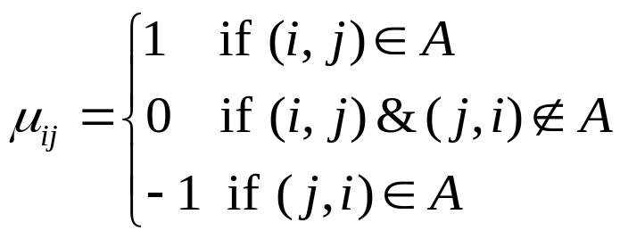
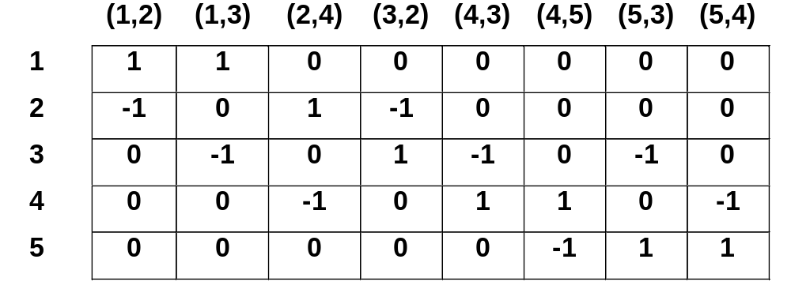
Node-Arc Incidence Matrix
Stores the network G = (N, A) as an n x m matrix N = {μ_{ij}}
with
2
(15,40)
4
(25,30)
1
(45,10)
(15,30)
(45,60)
(35,50)
(35,50)
3
5
(25,20)
It is the constraint matrix for the minimum cost flow problem.
One redundant row (linearly dependent)
Space and time inefficient.

Slide 15
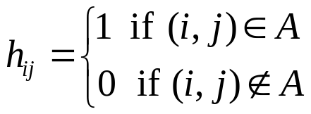
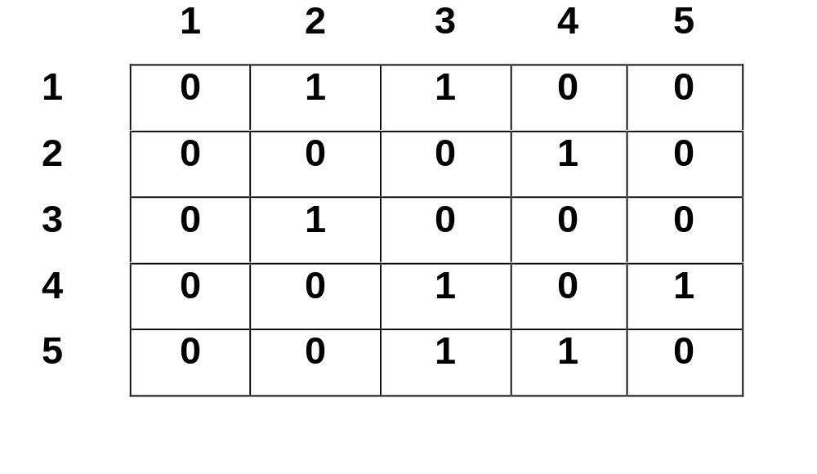
Node-Node Adjacency Matrix
Stores the network G = (N, A) as an n x n matrix H = {h_{ij}} with
2
(15,40)
4
(25,30)
1
(45,10)
(15,30)
(45,60)
(35,50)
(35,50)
3
5
(25,20)
Can store costs and capacities too
Easy to construct and manipulate
Space and time inefficient for sparse networks (that is, networks with m << n²)

Slide 16
Adjacency List
We maintain each adjacency list A(i) as a linked list of cells.
We maintain an n-dimensional array first, where first(i) stores a pointer to the first cell in A(i).
first
2
(15,40)
4
1
2
25
30
3
35
50
0
(25,30)
2
4
15
40
0
1
(45,10)
(15,30)
(45,60)
(35,50)
3
2
45
10
0
(35,50)
4
3
15
30
5
45
60
0
3
5
3
25
20
(25,20)
5
4
35
50
0
Space and time efficient
Little complex to manipulate

Slide 17
A network
2
We can view the arcs of a networks as a collection of sets.
1
3
Let A(i) be the arcs emanating from node i.
e.g., A(5) = { (5,3), (5,4) }
5
4
Note: these sets are static. They stay the same.
Common operations: find the first arc in A(i)
find the arc CurrentArc(i) on A(i)

Slide 18
Storing Arc Lists: A(i)
Operations permitted
  Find first arc in A(i)
  Store a pointer to the current arc in A(i)
  Find the arc after CurrentArc(i)
i
j
c_{ij}
u_{ij}
1
2
25
30
3
23
35
5
15
40
2
4
15
40
3
2
45
10
5
45
60
4
5
3
25
20
4
35
50

Slide 19
Current Arc
CurrentArc(i) is a placeholder for when one scans through the arc list A(i)
CurrentArc(1)
CurrentArc(1)
CurrentArc(1)
1
2
25
30
3
23
35
5
15
40
2
Finding CurrentArc and the arc after CurrentArc takes O(1) steps.
1
3
These are also implemented often using arrays called forward star representations.
5

Slide 20
Adjacency Matrix vs. Arc Lists
Adjacency Matrix?
  Efficient storage if matrix is very “dense.”
  Can determine if (i,j) ∈ A(i) in O(1) steps.
  Scans arcs in A(i) in O(n) steps.
Adjacency lists?
  Efficient storage if matrix is “sparse.”
  Determining if (i,j) ∈ A(i) can take |A(i)| steps
  Can scan all arcs in A(i) in |A(i)| steps

Slide 21
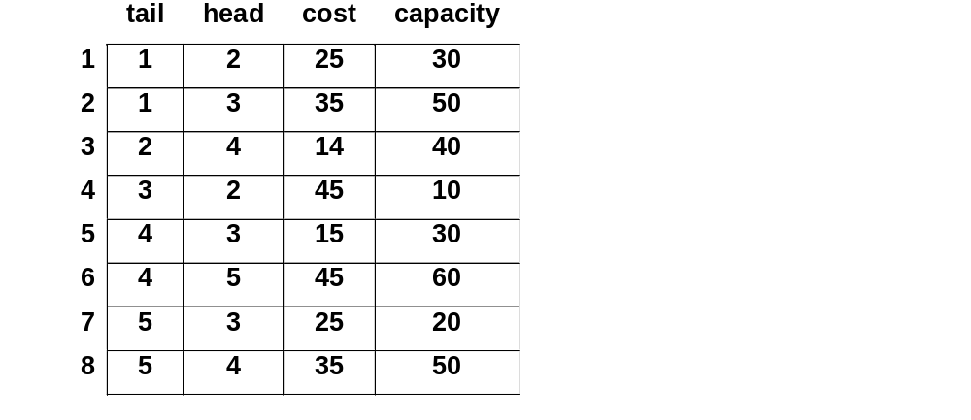
Forward Star
We first order the arcs in the increasing order of their tail nodes and store information in m-dimensional arrays in this order.
We maintain an n-dimensional array point, where point(i) stores the index where information about arcs emanating from node i begins.
point
2
(15,40)
4
1
1
(25,30)
2
3
3
4
1
(45,10)
(15,30)
(45,60)
(35,50)
4
5
(35,50)
5
7
3
5
(25,20)
6
9

Slide 22
Forward and Reverse Star
point
tail
head
cost
capacity
trace
rpoint
Incoming arcs:
(3,2)
(1,2)
(1,3)
(4,3)
(5,3)
(5,4)
(2,4)
(4,5)
1
1
1
1
2
25
30
4
1
1
1
2
3
2
1
3
35
50
1
2
1
2
3
4
3
2
4
15
40
2
3
3
3
4
5
4
3
2
45
10
5
4
6
4
5
7
5
4
3
15
30
7
5
8
5
6
9
6
4
5
45
60
8
6
9
6
7
5
3
25
20
3
7
node index
8
5
4
35
50
6
8
arc index
point(i): outgoing arcs of node i: point(i)~point(i+1)-1
rpoint(i): incoming arcs of node i: rpoint(i)~rpoint(i+1)-1
trace(a): a^{th} incoming arc has arc index trace(a)

Slide 23
Trees
A tree is a connected acyclic graph.
(Acyclic here, means it has no undirected cycles.)
If a tree has n nodes, it has n-1 arcs.
3
3
This is an undirected tree.
To store trees efficiently, we hang the tree from a root node.
1
6
4
2
5

Slide 24
Trees
Lists of children
3
3
1
4
2
2
1
6
3
1
6
4
5
4
2
5
6
5
node
1
2
3
4
5
6
3
1
0
1
6
3
pred
predecessor (parent) array

Slide 25
Stacks -- Last In, First Out (LIFO)
Operations:
create(S) creates an empty stack S
push(S, j) adds j to the top of the stack
pop(S) deletes the top element in S
top(S) returns the top element in S
top
6
6
5
5
5
9
2
pop(S)
2
pop(S)
2
push(S,9)
2
7
7
7
7
3
3
3
3

Slide 26
Queues – First in, First Out (FIFO)
Operations:
create(Q) creates an empty queue Q
Insert(Q, j) adds j to the end of the queue
Delete(Q) deletes the first element in Q
first(Q) returns the top element in S
6
5
2
7
3
Delete(Q)
front
rear
6
5
2
7
3
Delete(Q)
5
2
7
3
Insert(Q,9)
2
7
3
9

Slide 27
Heaps (Priority Queues)
Priority queue: any data structure that supports the operations of search min, insert, and delete min (or max)
Each element j has a value key(j)
create(P, S) initializes P with elements of S
Insert(P, j) adds j to P
Delete(P, j) deletes j from P
FindMin(P, k) k: index with minimum key value
ChangeKey(j, Δ) key(j):= key(j) + Δ.
A common data structure, the first one that cannot be implemented as a doubly linked list.
Goal: always locate the minimum key, the index with the highest priority.

Slide 28
Binary Min-Heap
Heap: a min heap is a complete binary tree with the property that the value at each node is ≦ the values at its children
Suppose there are n elements in the heap:
Search min: O(1) (i.e. the toppest node)
Insert an element: O(log n)
put the new element to the last node, then compare with its ancestors, swap parents/children when necessary
Delete min: O(log n)
delete the toppest node, put the last node to be the toppest, then compare with its descendants, swap parents/children when necessary

Slide 29

More about Binary Heap
Why is the depth of a binary tree “log n” for a tree of n nodes?
Since we keep “balanced” binary tree, suppose totally n nodes,
Graphical illustration of inserting & deleting an element in min-heap
5
5
5
5
5
2
11
120
11
120
11
20
11
20
11
2
11
5
40
100
40
100
20
40
100
120
40
100
120
2
40
100
120
20
40
100
120
20
Original min-heap
Insert a new element 20
Insert a new element 2
20
5
5
5
3
11
5
11
5
11
20
11
20
3
20
5
20
40
100
120
20
40
100
120
40
100
120
40
3
120
40
11
120
40
11
120
Delete an element 2
Change element 100 to be 3

Slide 30
Summary of Heaps
create(P, S) O( n ) time; |S| = O(n)
Insert(P, j) O( log n ) time
Delete(P, j) O( log n ) time
FindMin(P, k) O( 1 ) time
ChangeKey(j, Δ) O( log n) time
The standard data structure to implement heaps is binary heaps
Can be used to sort n unsorted array in O(n log n) by repeatedly finding and deleting the minimum.
Why O(n)?

Slide 31
Sorting using Priority Queues
6
6
9
9
2
2
5
5
8
8
4
4
7
7
2
4
5
6
7
8
9
Each find min takes O(1) and delete min take O(log n) steps. So the running time for sorting is O(n log n) .
There are many other comparison based sorting methods that take O(n log n) .

Slide 32
Binary Search
In the ordered list of numbers below, stored in an array, determine whether the number 25 is on the list.
1
2
3
4
5
6
7
8
9
10
11
12
13
14
2
4
6
9
13
17
22
24
27
31
33
36
42
45
Left
Right

Slide 33
Binary Search
In the ordered list of numbers below, stored in an array, determine whether the number 25 is on the list.
1
2
3
4
5
6
7
8
9
10
11
12
13
14
2
4
6
9
13
17
22
24
27
31
33
36
42
45
Left
Left
Right

Slide 34
Binary Search
In the ordered list of numbers below, stored in an array, determine whether the number 25 is on the list.
7
8
9
10
11
12
13
14
22
24
27
31
33
36
42
45
Left
Right
Right
After two more iterations, we will determine that 25 is not on the list, but that 24 and 27 are on the list.
Running time is O( log n) for running binary search.

Slide 35
Summary
Review of data structures
  Lists, stacks, queues, sets
  priority queues
  binary search

